Slide 1
32b – Clean Code – Monostate, NullObject and Proxy Patterns
Based on the CleanCoders videos by Uncle Bob Martin
Rupert Waldron

Slide 2
Monostate Pattern
Singleton pattern is great when you only want one of an instance like a ServiceRegistry
Monostate Pattern is good if you only want one of an instance but you don’t want anyone else to know it is only one instance.

Slide 3
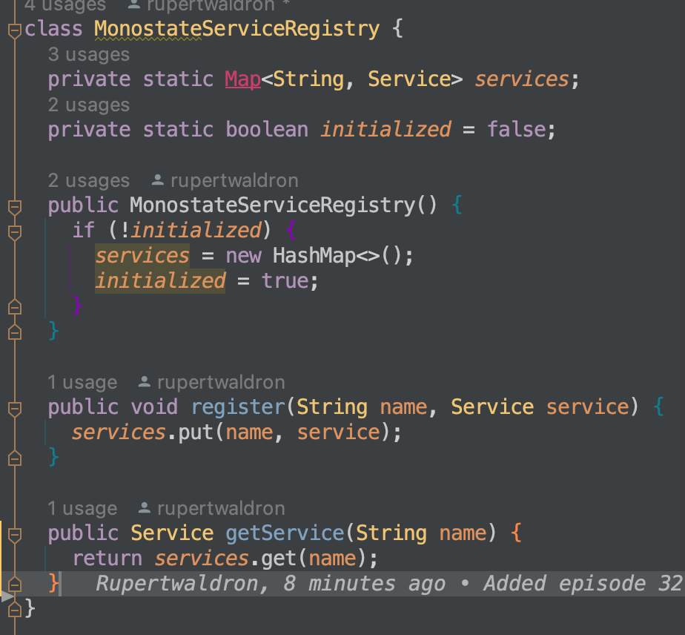
Monostate Pattern
Monostate pattern uses a public constructor so you can create many instances, but all the variables are held in a static map – see the code.
The state remains after all the instances have been destroyed – ready for the next instance to be created
You can also create derivatives of the monostate class and have different policies for controlling the same information.

Slide 4
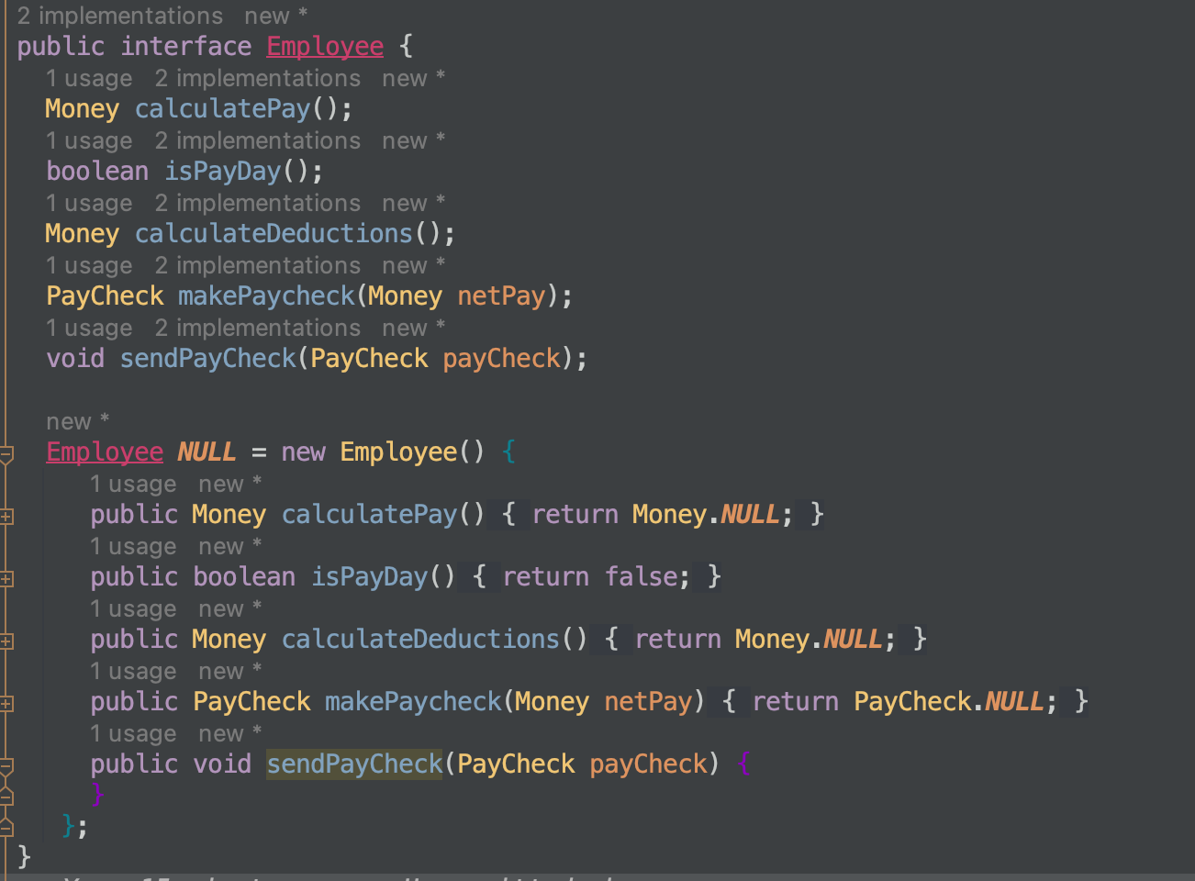
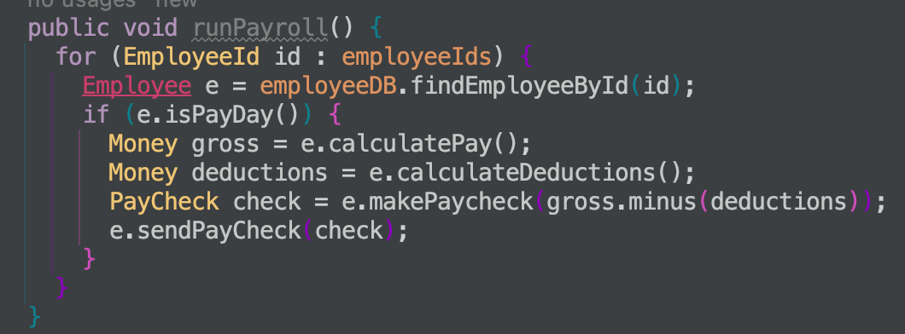
NullObject Pattern
When you don’t want to return null if something doesn’t exist. Normally you would have to check for null – or forget and get a nullpointer exception.
This nullObject implements all the methods of the normal object – but typically they do nothing.
This nullObject implementation ensures that it will slip through the system with no consequences – isPayDay() returns false

Slide 5
Proxy Pattern
The Proxy Pattern provides a surrogate or placeholder for another object to control access to it
The proxy object wraps the real by containing an instance of it and implementing the same interface
Real Object
Data in
Proxy Object

Slide 6
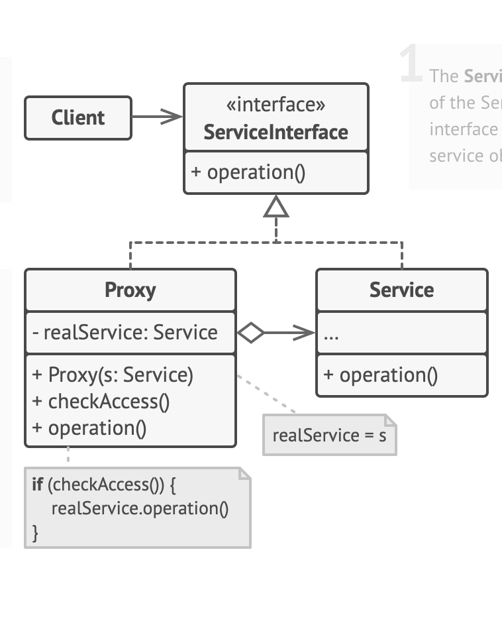
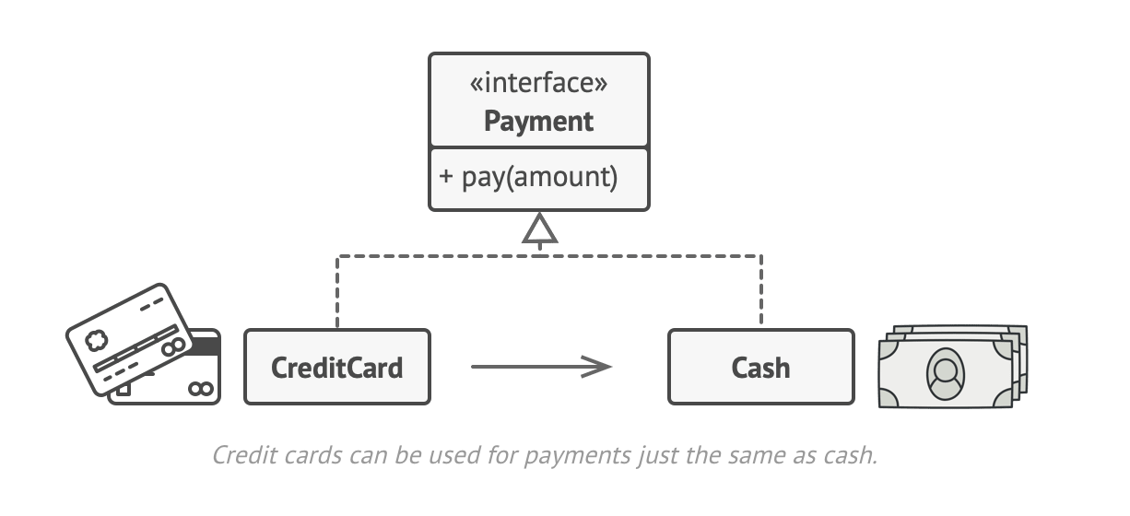
Proxy Pattern
The Proxy Pattern provides a surrogate or placeholder for another object to control access to it
Real world analogy
Look at the code for another example

Slide 7
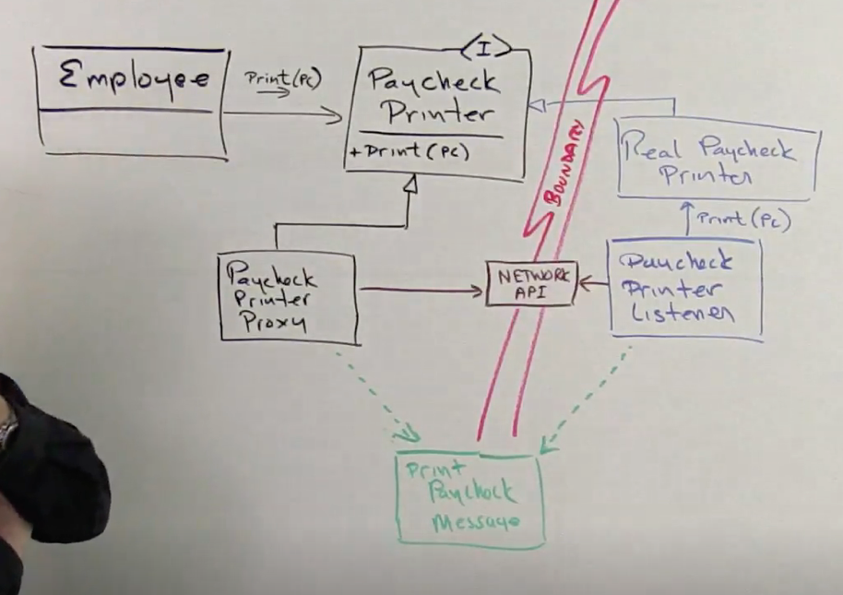
Proxy Pattern
The Proxy Pattern enables communication over a network invisible to the client
The Employee wants to print(pc). The real paycheck printer is over a network somewhere else.
The Paycheck Printer Proxy implements Paycheck Printer Interface and print(pc) is called upon it.
The proxy then constructs a print paycheck message to send over the next work to the paycheck listener (e.g. controller) which then calls the real paycheck printer.

